Slide 1

Introduction to Computer Free RTOS _ Task Management
Professor : Jake Tarn
Lecturer: Sunny

Slide 2
Creating Tasks

Slide 3
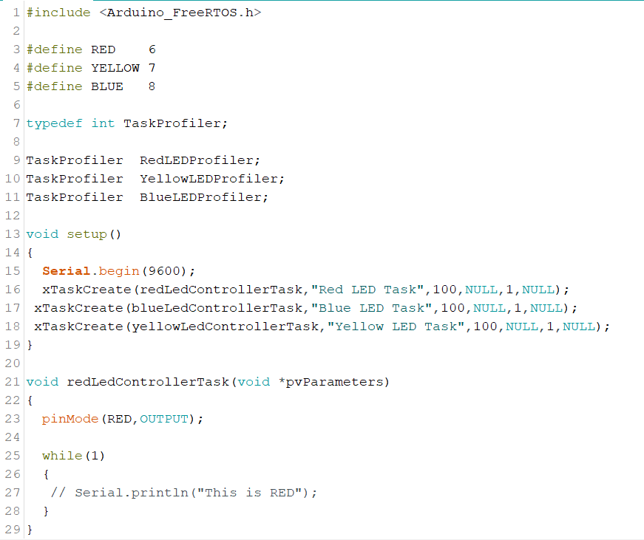

Slide 4
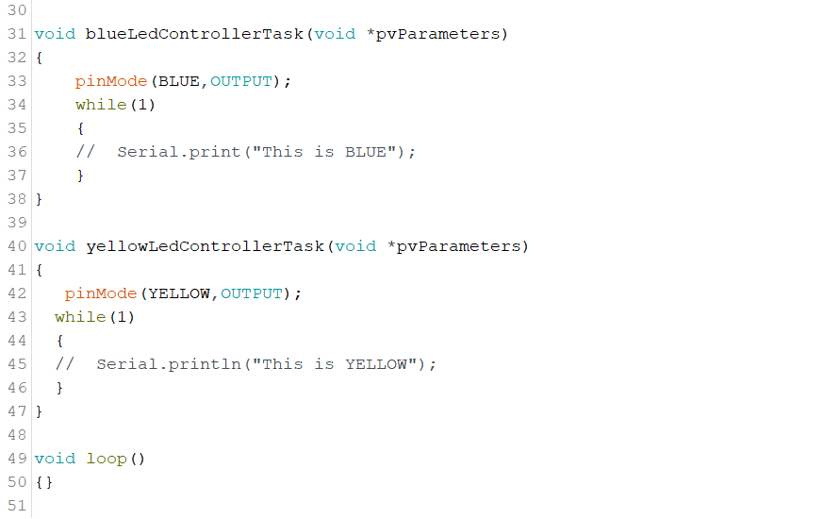

Slide 5
Using Task Parameters

Slide 6
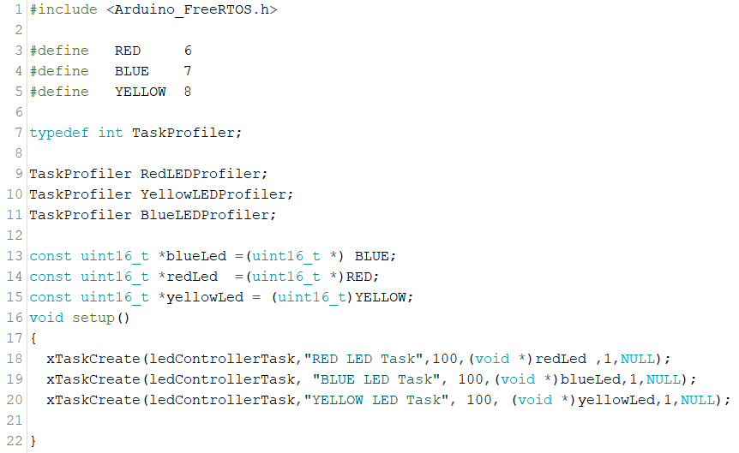

Slide 7
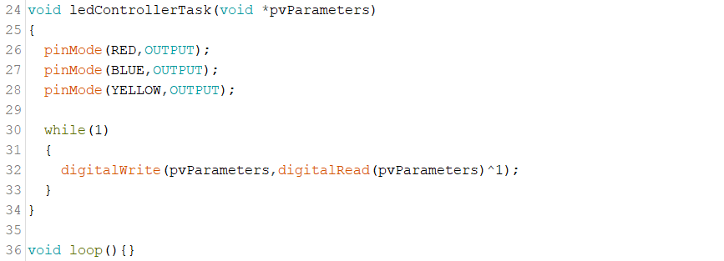

Slide 8
Experimenting with Task Priorities

Slide 9
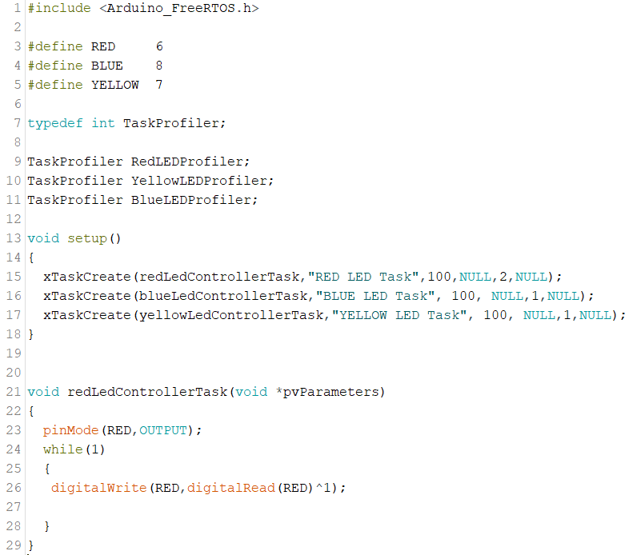

Slide 10
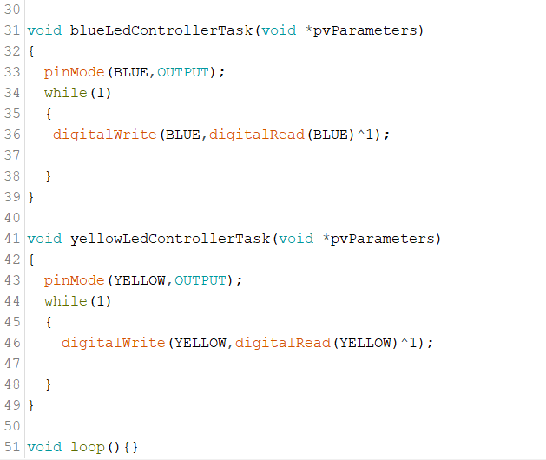

Slide 11
Changing Task Priority at run-time

Slide 12
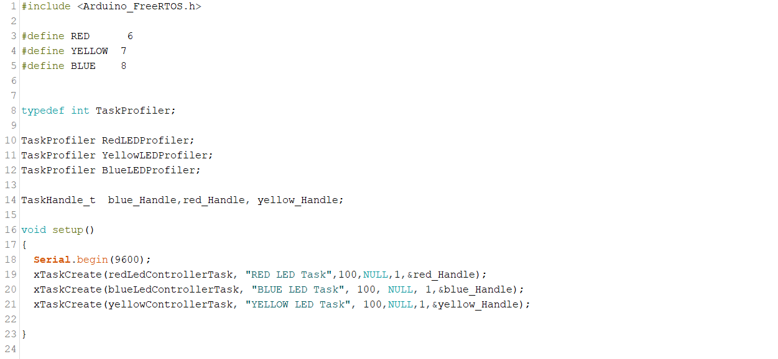

Slide 13
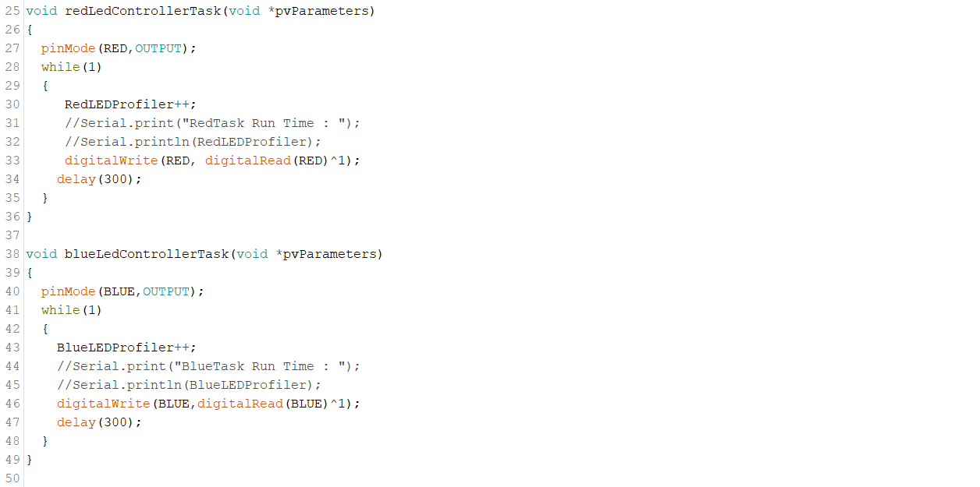

Slide 14
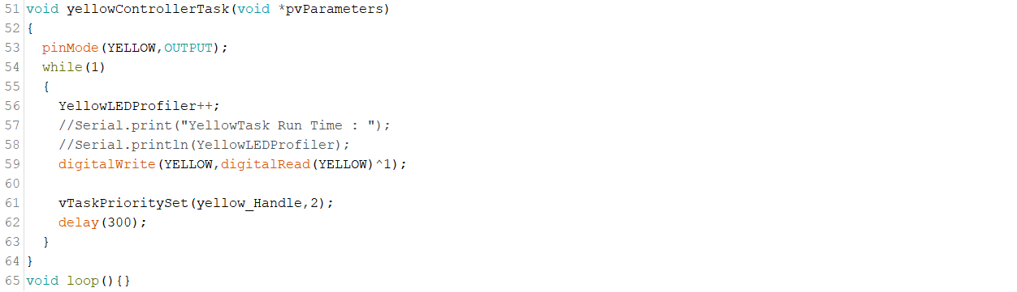

Slide 15
TASK Changing it’s own Priority

Slide 16
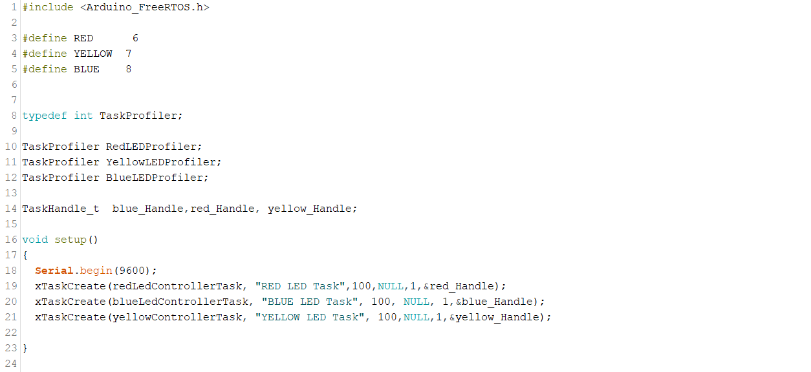

Slide 17
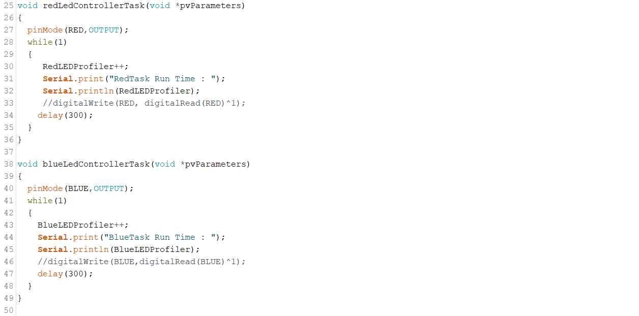

Slide 18
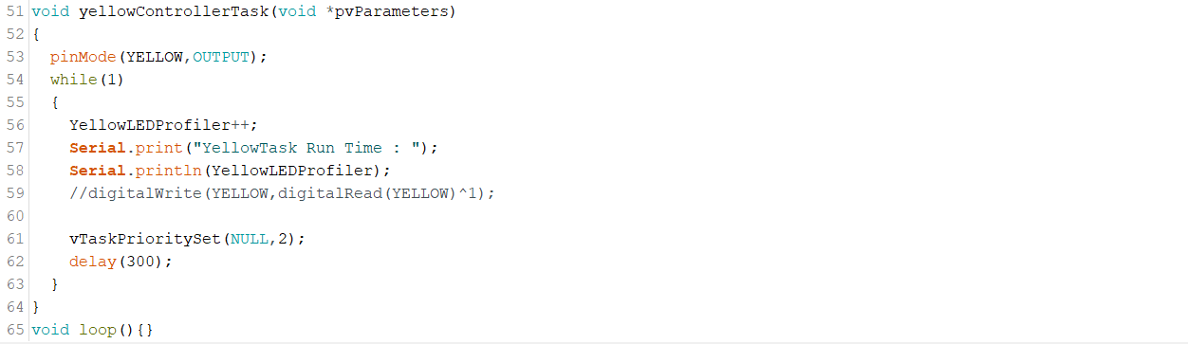

Slide 19
Getting the TASK Priority

Slide 20
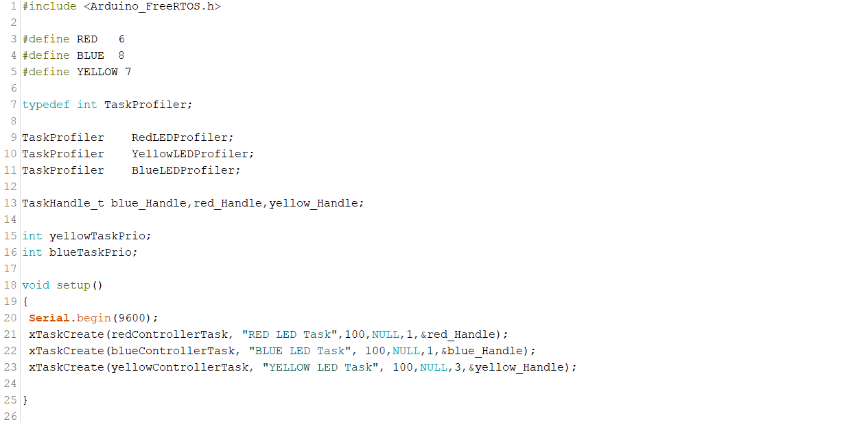

Slide 21
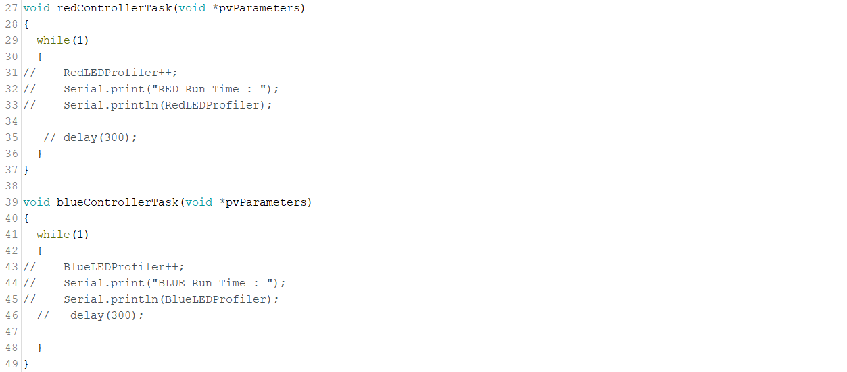

Slide 22
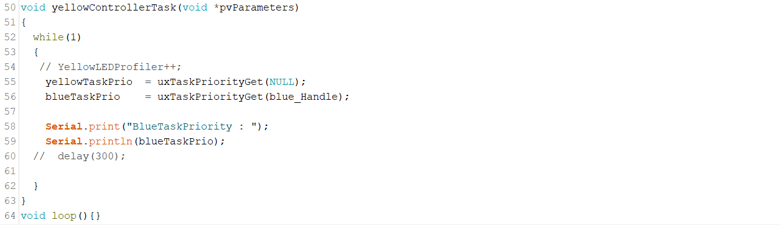

Slide 23
Suspending a Task

Slide 24
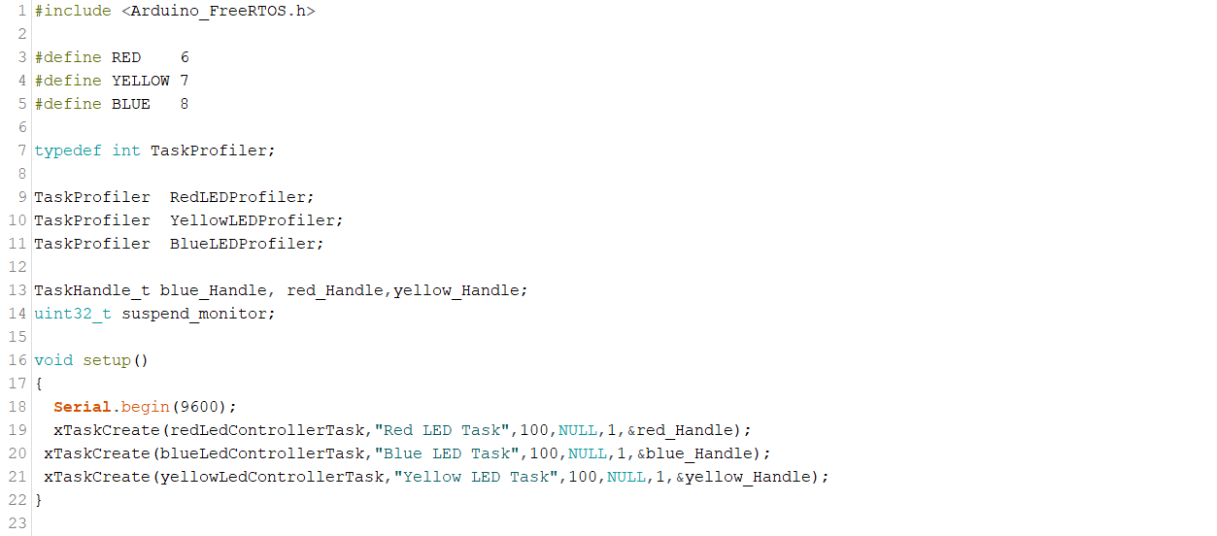

Slide 25
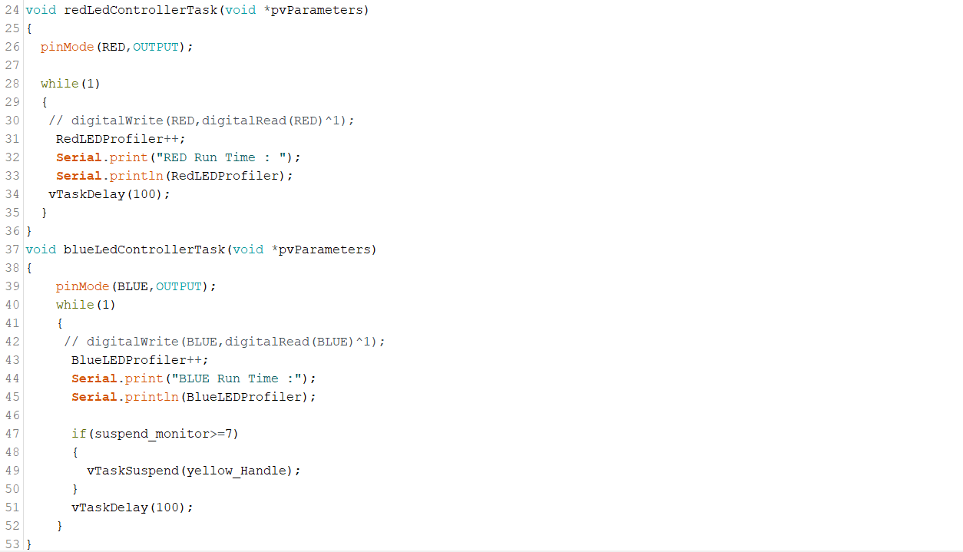

Slide 26
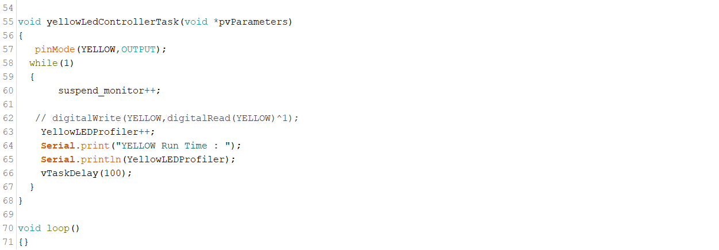

Slide 27
Suspending itself

Slide 29
Resuming a Suspended Task

Slide 30
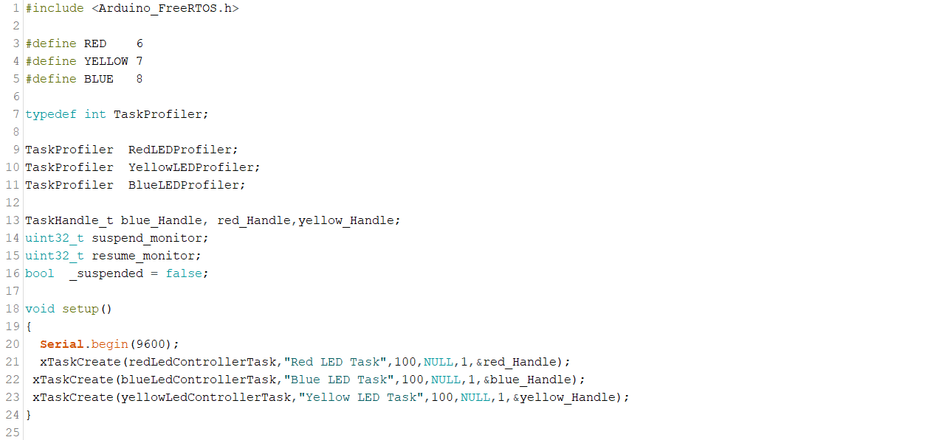

Slide 31
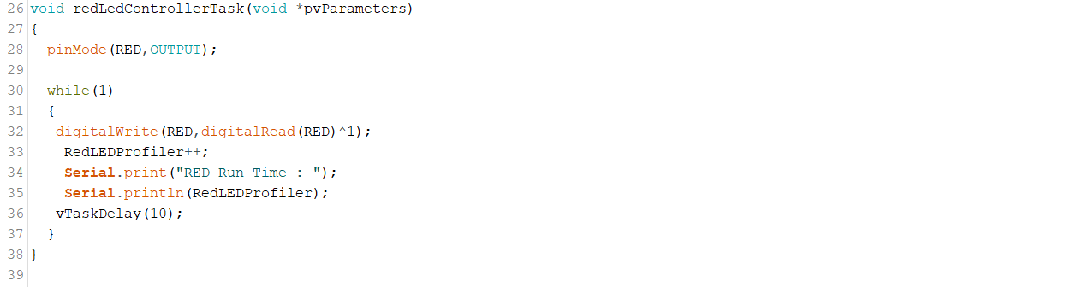

Slide 32
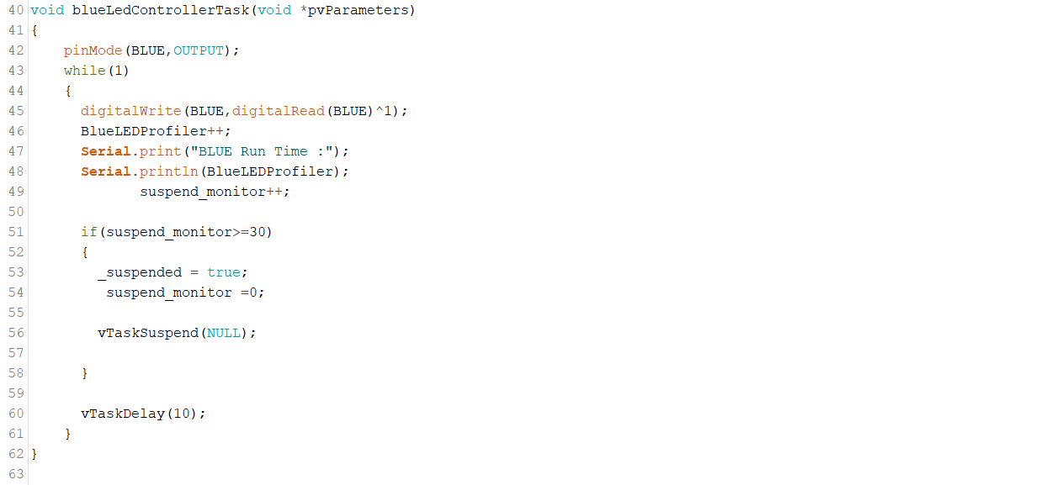

Slide 33
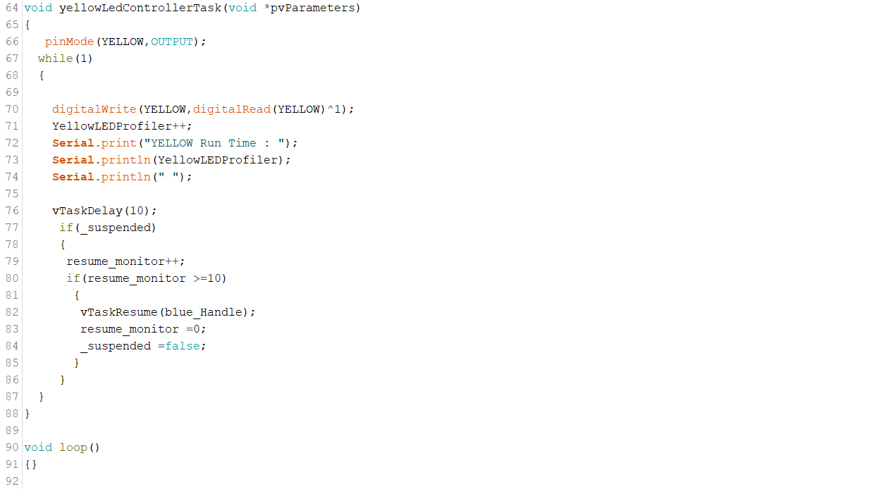

Slide 34
Blocking Tasks with vTaskDelay()

Slide 35
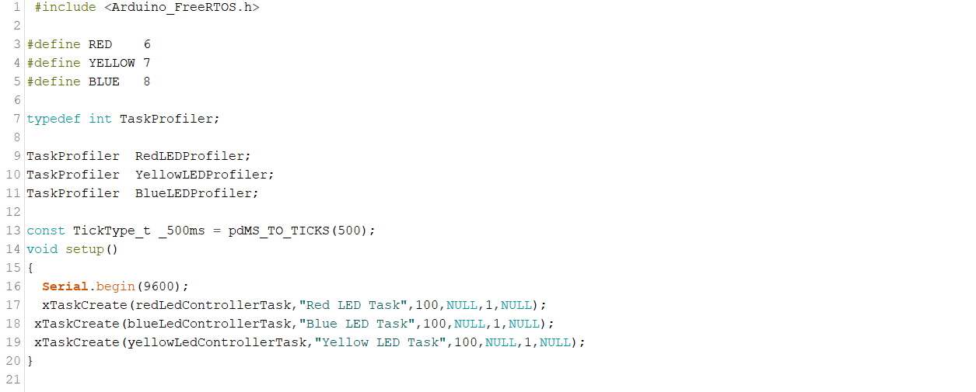

Slide 36
